Slide 1
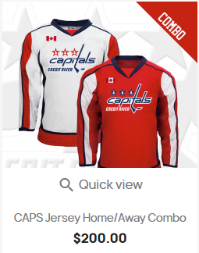
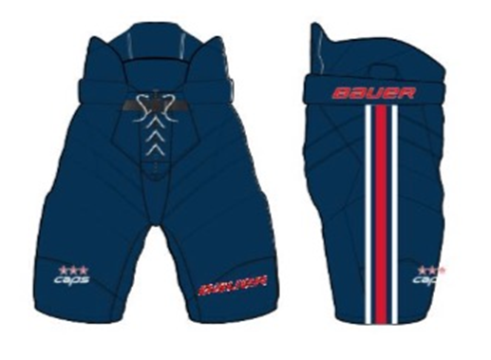
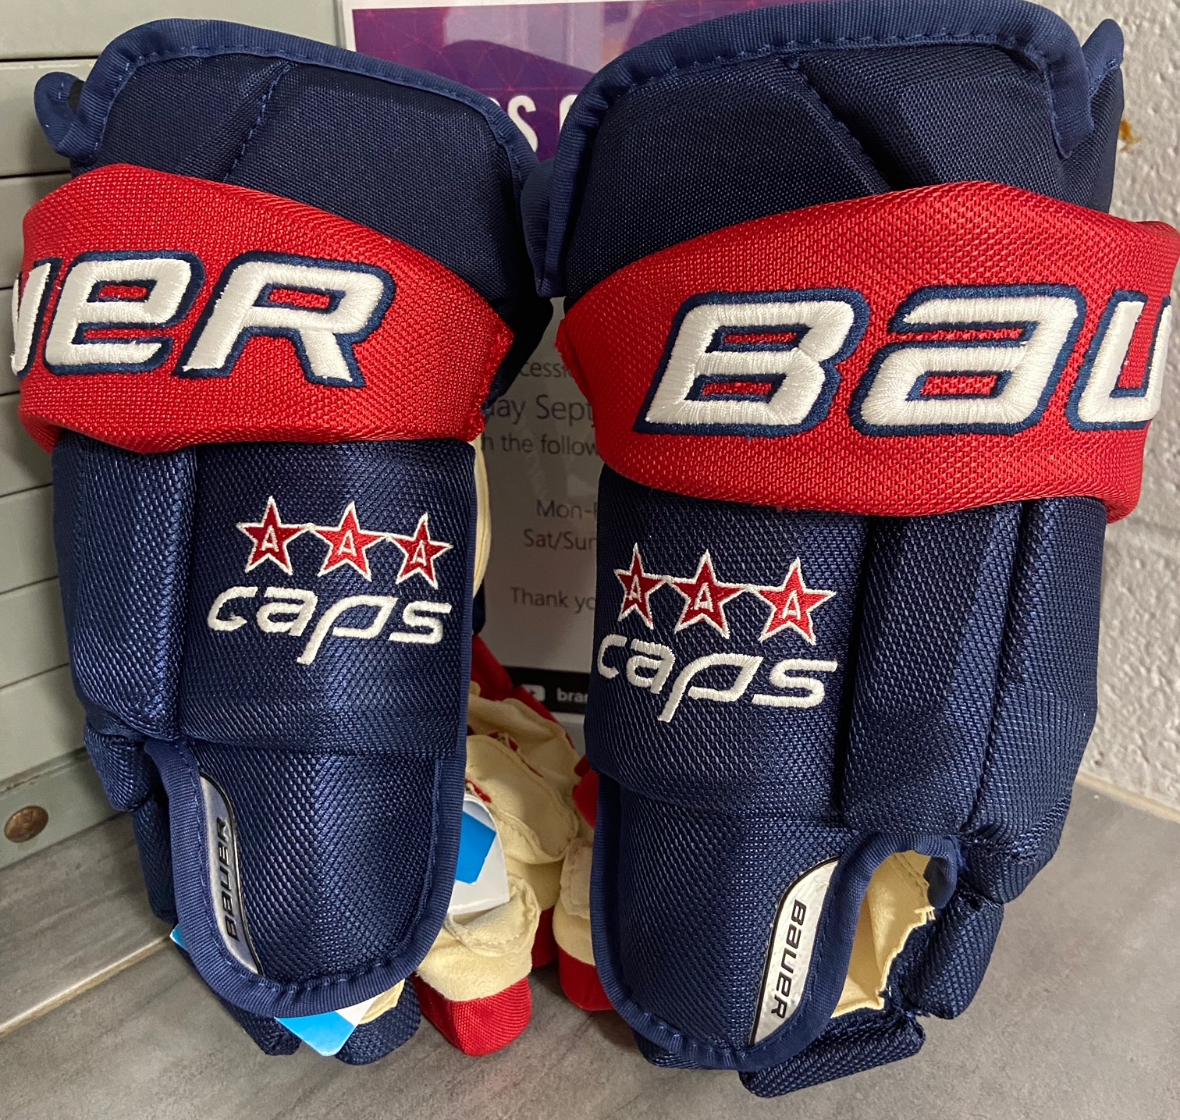
Players Mandatory Game Wear - Sportfix
Pant Shells: $79.10 Taxes Included
Gloves: $192.10 Taxes Included
$271.90 Taxes Included (Socks included too)
Total: $543.10 Includes tax

